Slide 1
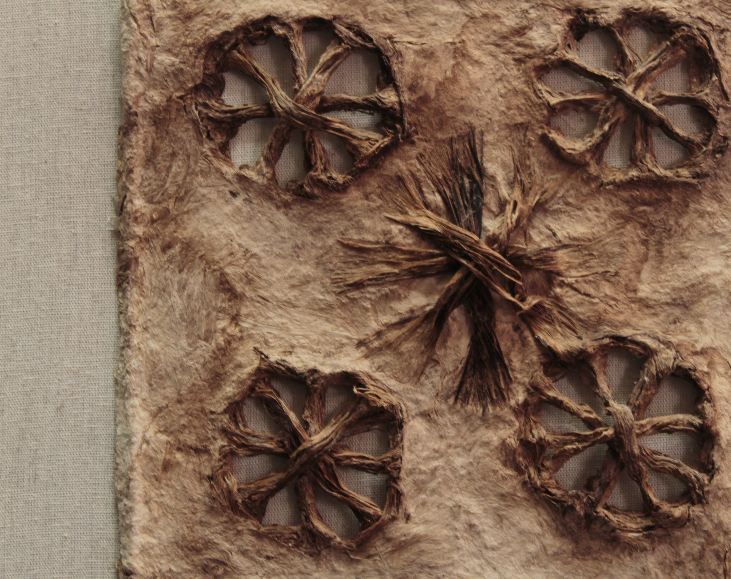
Papel Mágico:
A Comparative Analysis of Pre-Hispanic Papel Amate Rituals
By: Regina Telinski
Ursula | stock.adobe.com

Slide 2
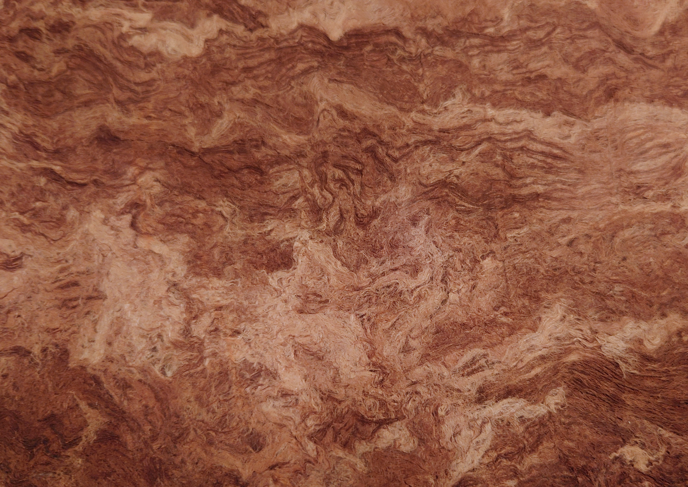
Abstract
Papel amate, a traditional bark paper, holds profound ceremonial and artistic value across various pre-Hispanic cultures in Mesoamerica. This research explores the ritual uses of papel amate by the Mexica, Maya, and Otomi peoples -three groups with the most substantial historical records and ethnographic research regarding their use of papel amate. The Mexica and Maya typically use papel amate mainly for ritual offerings, creating codices, and painted iconography. The Otomi used papel amate for ritual in a distinctive manner, (which was later adopted by the Mexica), crafting intricately cut figures from the paper used in shamanic rituals of healing, ceremonies, and spirit communication.
This research paper acknowledges that additional indigenous cultures in Pre-Hispanic Mesoamerica created and utilized papel amate in a similar fashion; however, much of the historical records are lost or have been destroyed due to the devastating effects of colonialism in the region. For this reason, this research paper focuses on the remaining historical evidence and records from the Mexica, Mayan, and Otomi peoples. By analyzing ethnographic sources and historical codices, this paper seeks to deepen understanding of the role papel amate played in Mexica, Mayan, and Otomi rituals.
Richard Marx | stock.adobe.com

Slide 3
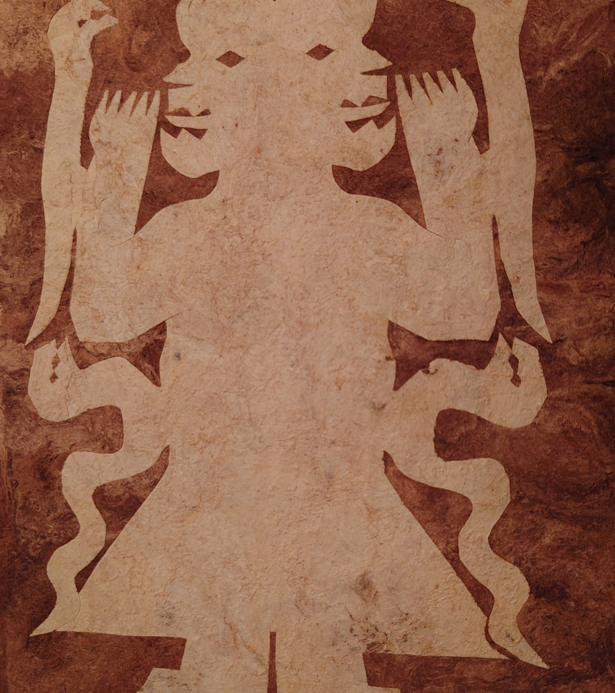
What is Ritual?
Suzanne Preston Blier’s chapter in the book Critical Terms for Art History beautifully exemplifies the ever-evolving nature of the ritual: “like a musical score, a ritual assumes a new identity each time it is repeated” (Blier 2003, 302).
There is a meditative quality to ritual by focusing on the present, creating a unique experience each time the ritual is performed, regardless if each step is identical to the previous iteration.
Because of ritual’s ever-evolving nature, it can be seen as an infinite expression of humanity’s history and beliefs, and researchers can learn a lot about a particular culture through their distinct rituals and in the ways in which they evolve over time.
Richard Marx | stock.adobe.com

Slide 4
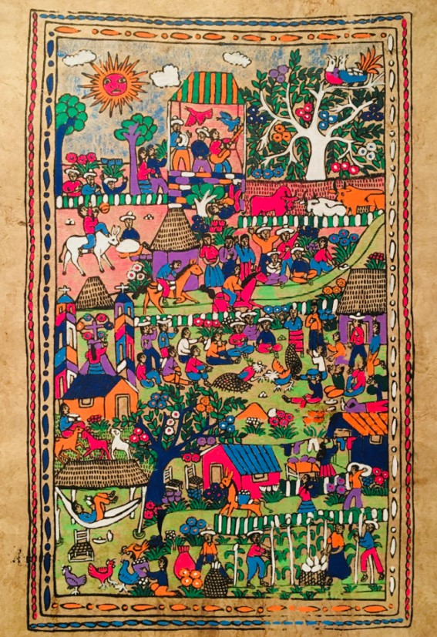
Mexica Amate Rituals
Utilized papel amate for
  Administrative, political, and ritual purposes
Tributes
  480,000 sheets of paper were to be given in tribute annually to the state of Tenochtitlan
Festivals
  18 festivals annually (one per calendar month)
  Used in ceremonial garments
  Used as sacred adornments during human sacrifice rituals
    The body and blood stained paper would be burned together
Sacred books called Tonalamatl (Neumann 1973, 149)
Mexica culture develops a unique painting style to create papel amate artwork reflecting their culture
Mexican Amate Paintings. Museum of International Folk Art, Date unknown. https://www.internationalfolkart.org/learn/lesson -plans/mexican -amate-paintings.html

Slide 5
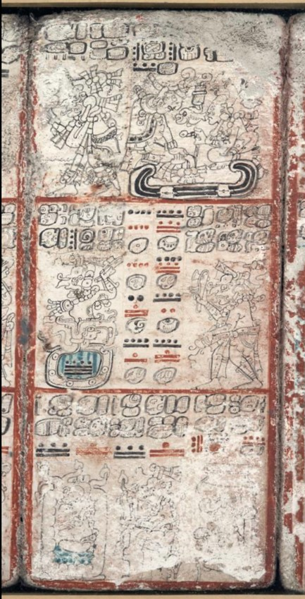
Maya Amate Rituals
Called Huun, a glyph meaning “book” and “paper,” within the Maya community
Codices containing glyph writings on history, engineering, astronomy, politics and spirituality
Ritual ribbons that wrap around the head, a symbol of rank (Stuart, David. "Codices Mayas." Artes de México, no. 109 (March 2013): 24–35))
Bloodletting ritual of bleeding onto torn pieces of papel amate that is then offered (usually by burning) to sustain the gods
The Dresden Codex. [Place of Publication Not Identified: Publisher Not Identified, 1250 to 1200] Pdf. https://www.loc.gov/item/2021667917/.

Slide 6
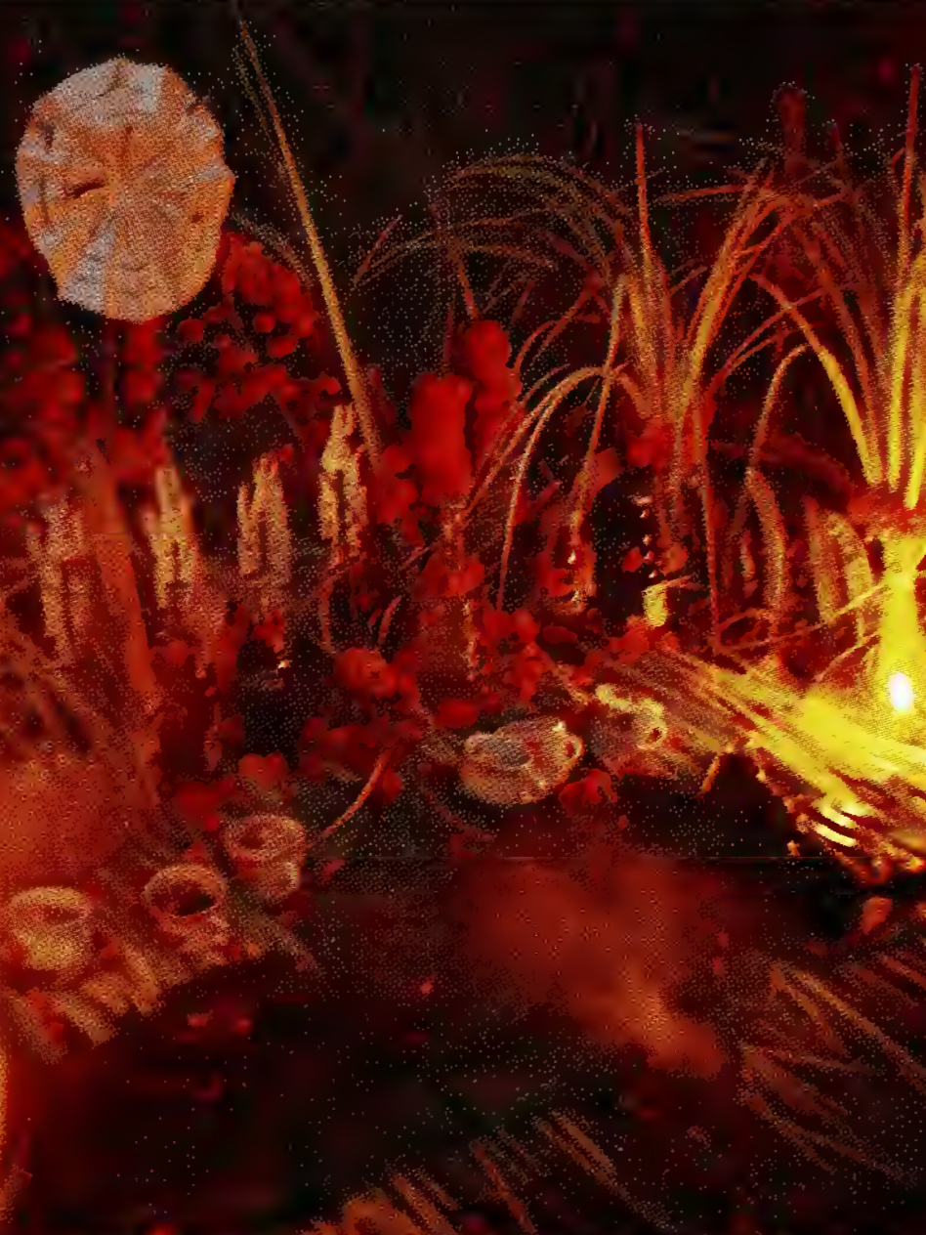
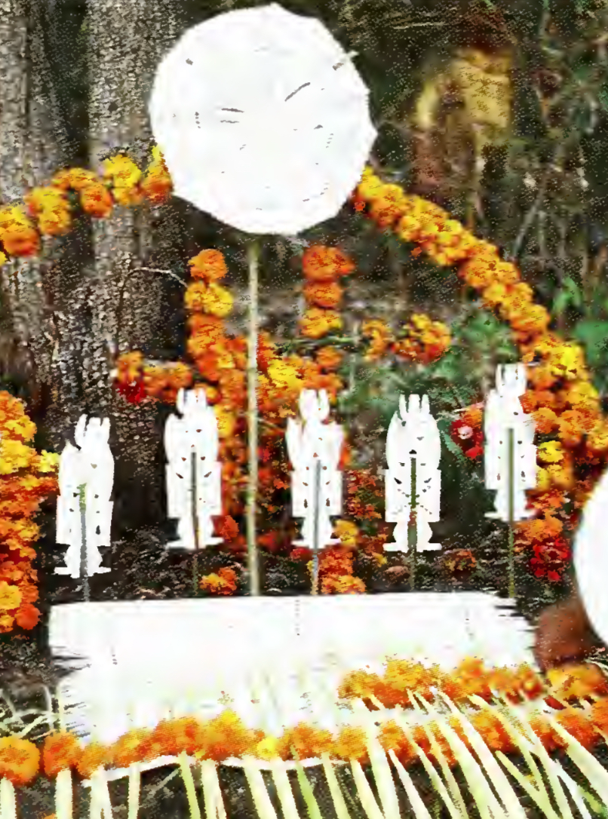
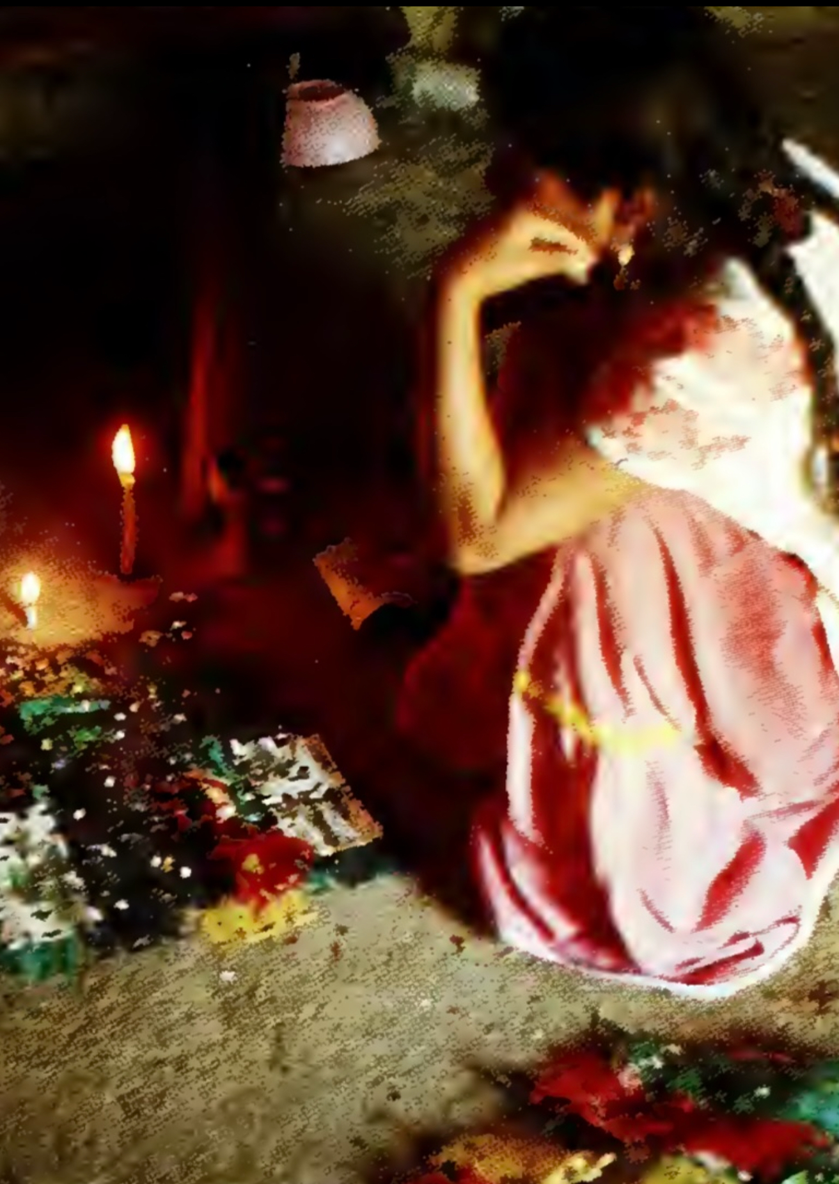
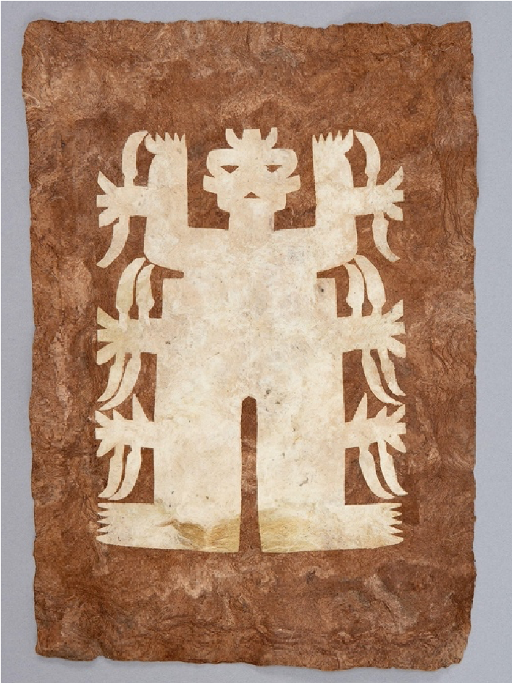

Otomi Amate Rituals
Figures 1-3: Sandstrom, Alan R., and Pamela E. Sandstrom. Traditional Papermaking and Paper Cult Figures of Mexico. Norman: University of Oklahoma Press; Eurospan distributor, 1987.
Figure 4: n.d. Mulberry bark, fig bark, overall: 30.1 cm x 20.8 cm. UBC Museum of Anthropology. https://jstor.org/stable/community.12516913.
The role of Shaman is one that bridges the physical and spiritual worlds, called pati in Otomi, or “person of knowledge”
Otomi spirituality is pantheistic and papel amate rituals are associated with animism, infusing life force called Zaki into the paper cut figures they work with
Papel amate is cut into figures of deities whose zaki (life force) is called into the paper by the shaman, now ready to be used in rituals
Los Costumbres is the name of the vast array of rituals involving paper cut out amate figures
Elaborate altars are constructed, rows of papel amate figures line the altar, there are offerings of food and flowers, anointing, and forms of prayer (Sandstrom and Sandstrom 2022, 19)

Slide 7
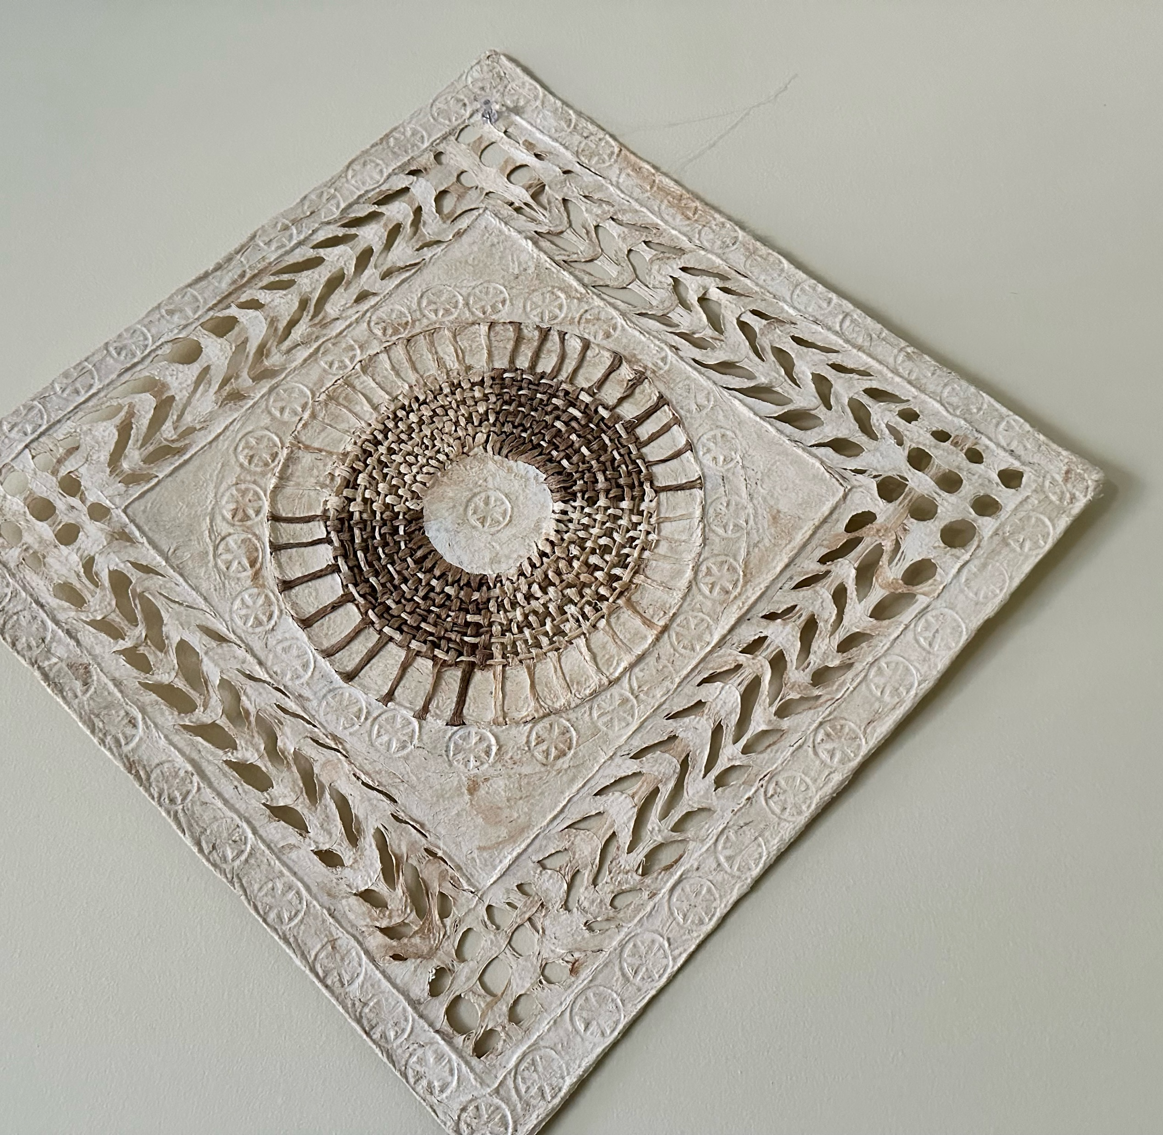
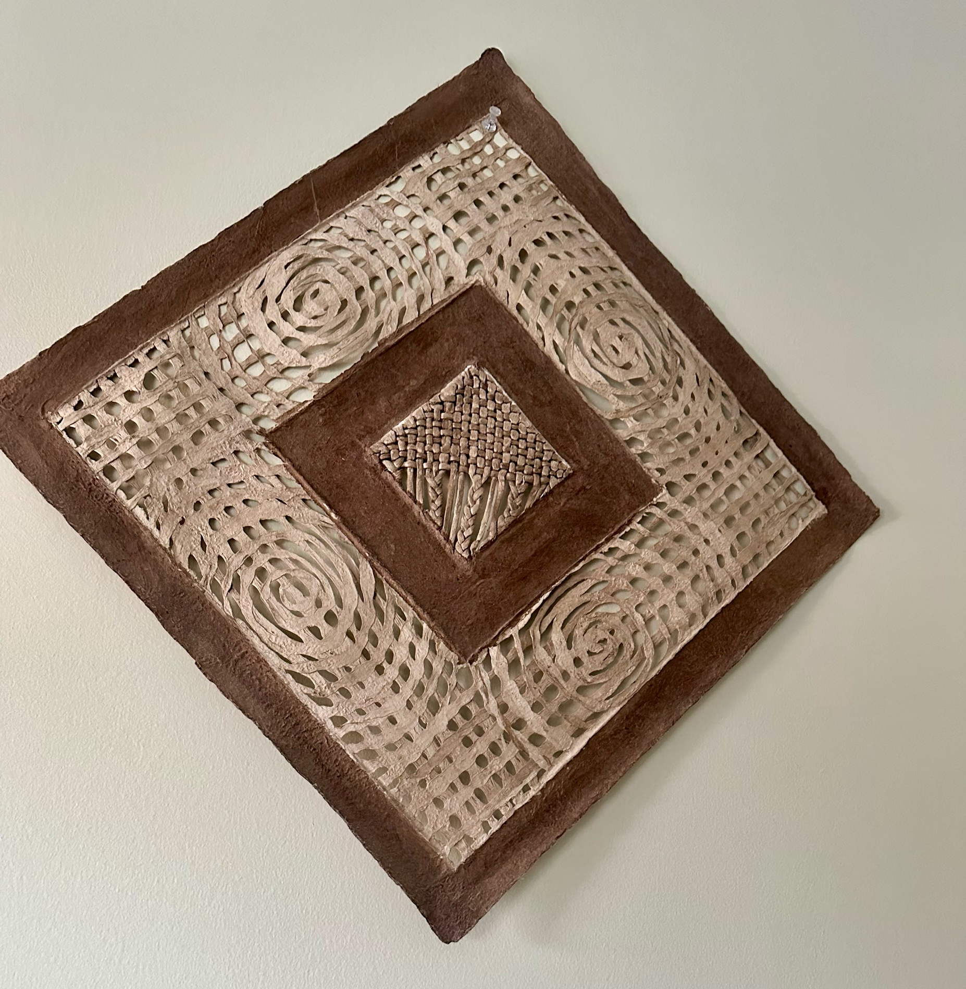
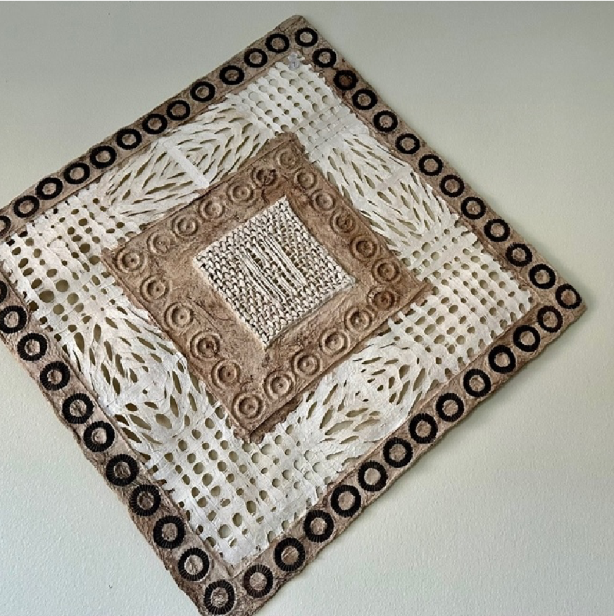
Contemporary Papel Amate
Contemporary Papel Amate, Photography: Rocio Telinski, 12/03/2024
The mulberry plant (in addition to other natural fibers) becomes a common material utilized in papel amate production in order to not over harvest the wild fig tree plant population.
Commercialized papel amate sometimes looses the essence of what it is when detached from its ritual purposes.
Papel Amate is a source of income for skilled indigenous craftspeople across Mexico
Otomi Shamans continue to practice with papel amate
Mexica culture creates beautiful painted papel amate
Our oldest surviving Mayan codices are created with papel amate

Slide 8
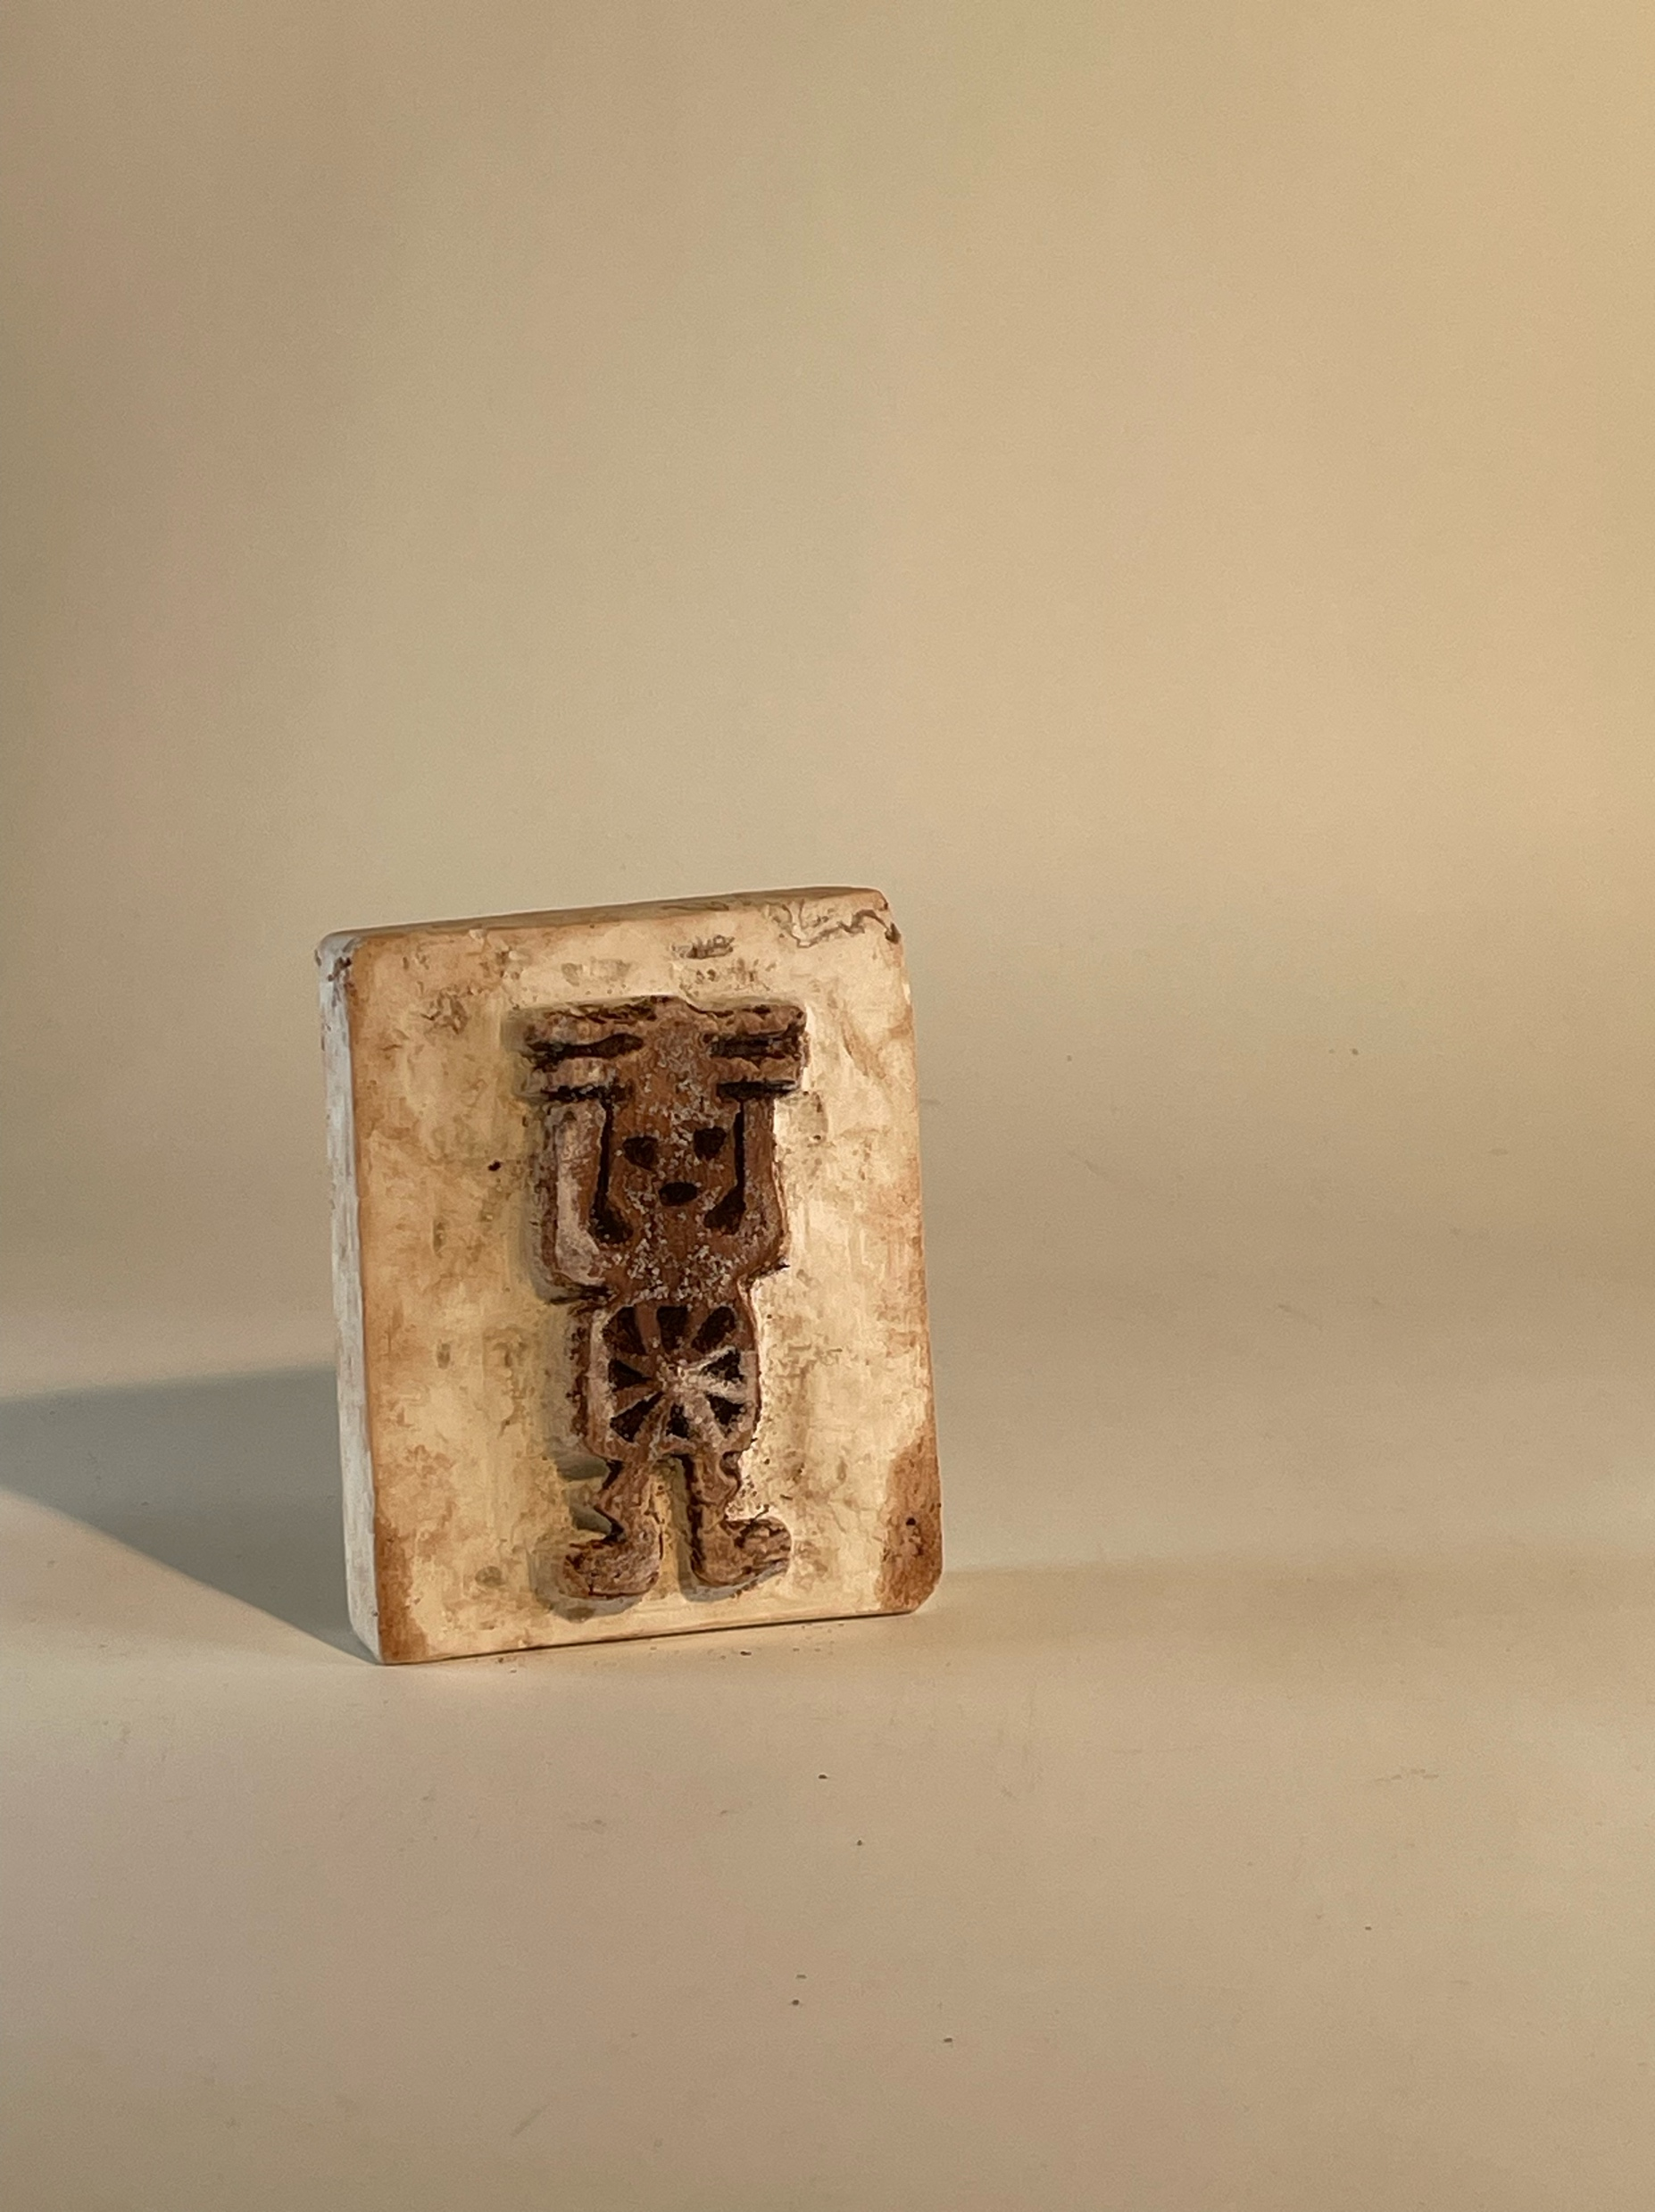
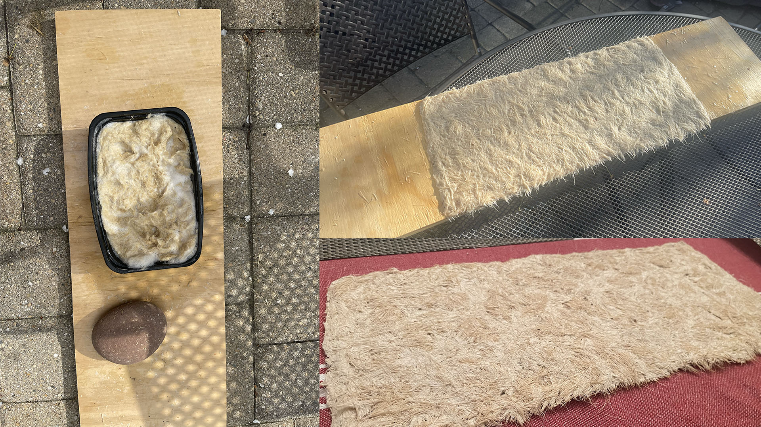
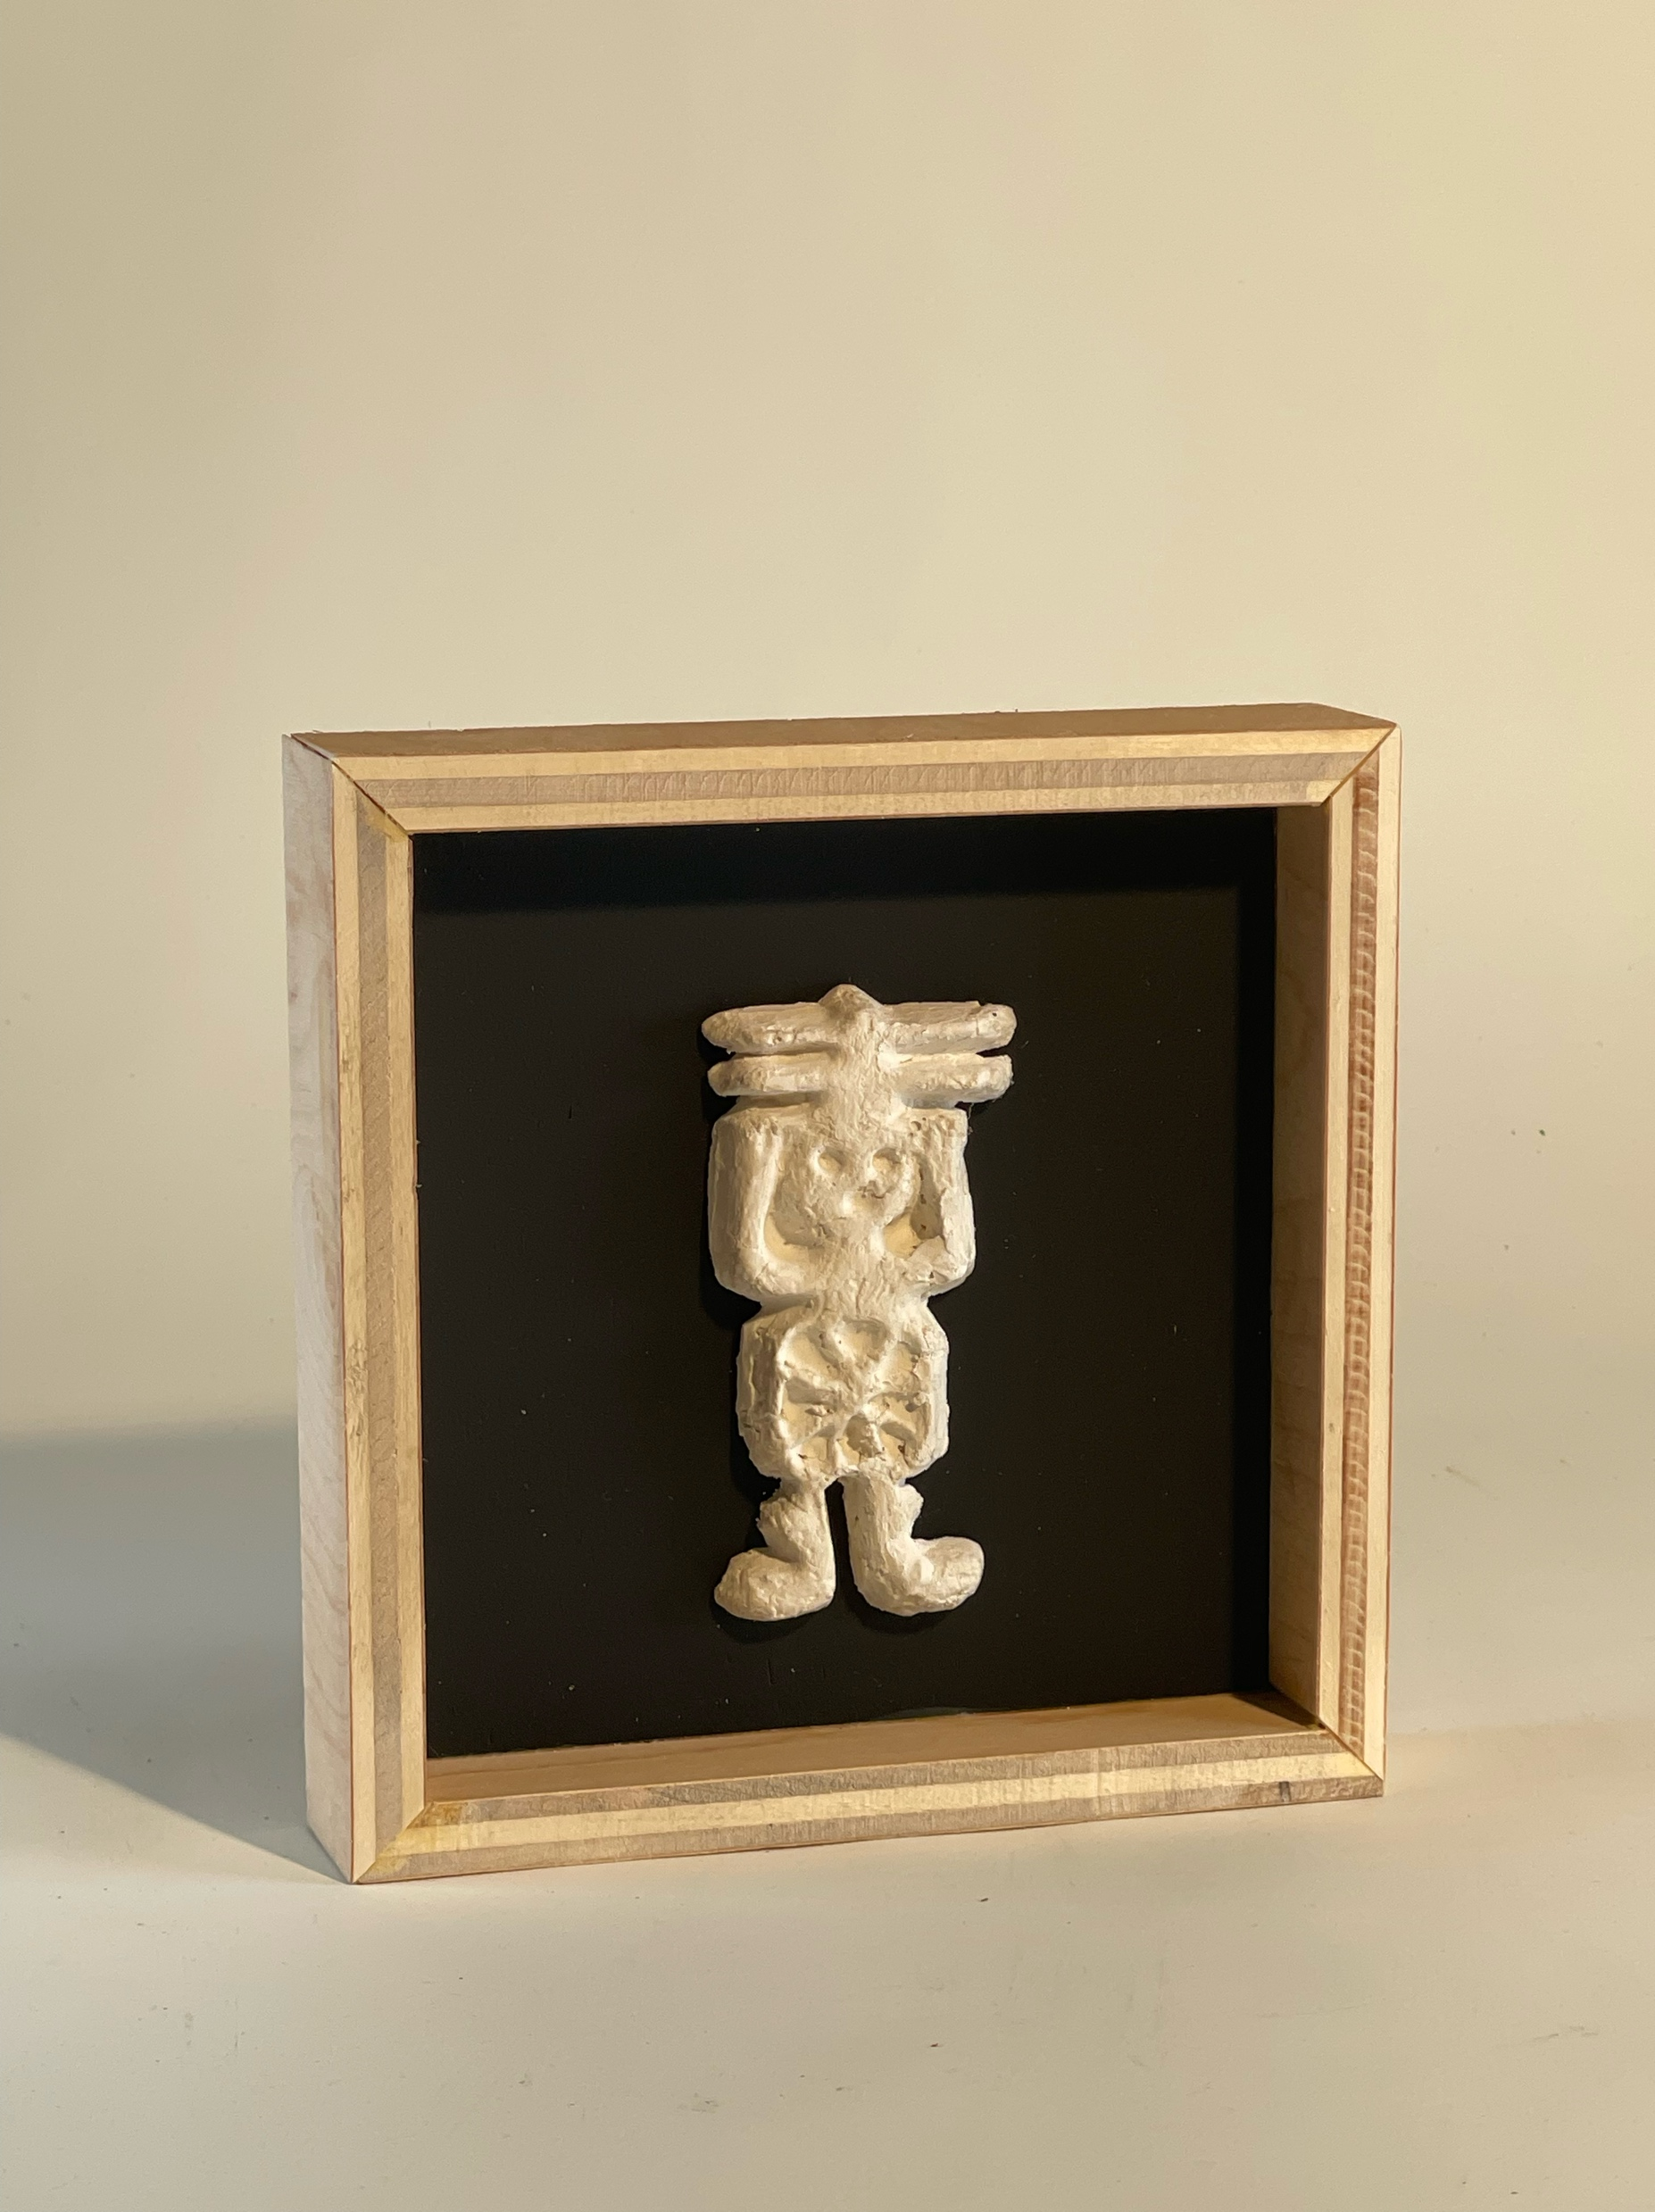
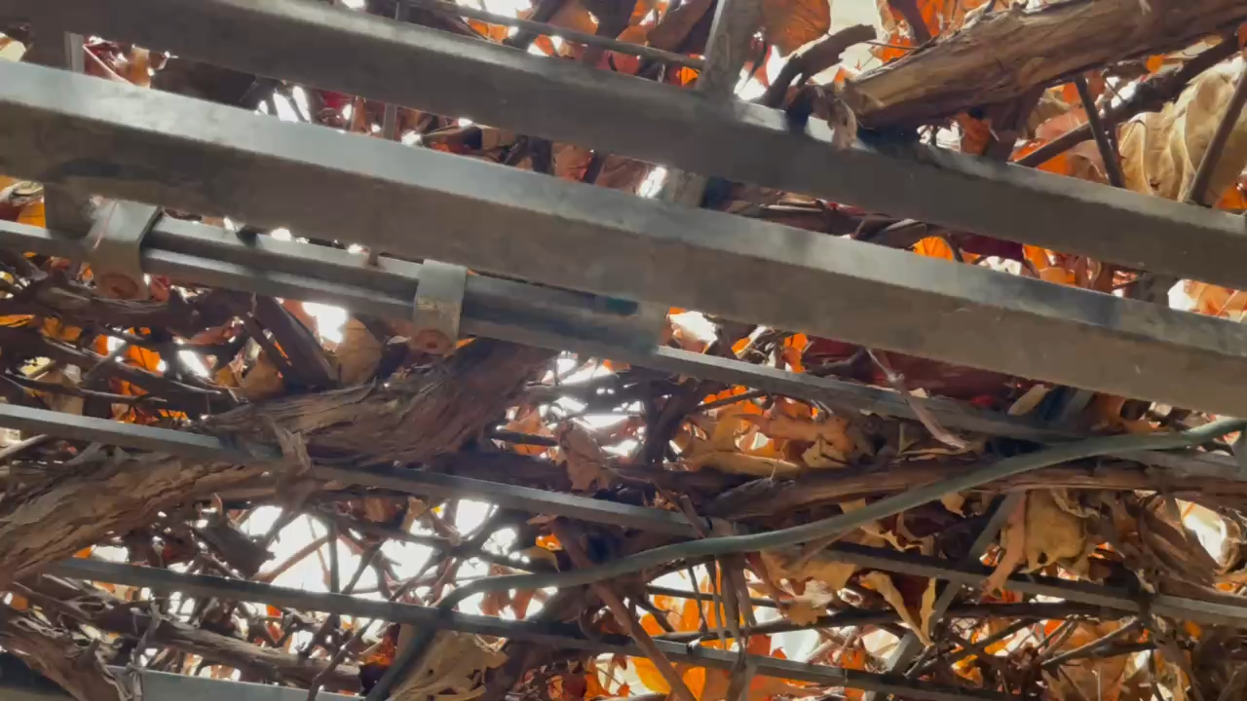
My Personal Papel Amate Ritual
Creating papel amate connects me to nature, craft, and my Mexican heritage
The act of making papel amate is deeply meditative
Art honoring my favorite Otomi legend of the sun god

Slide 9
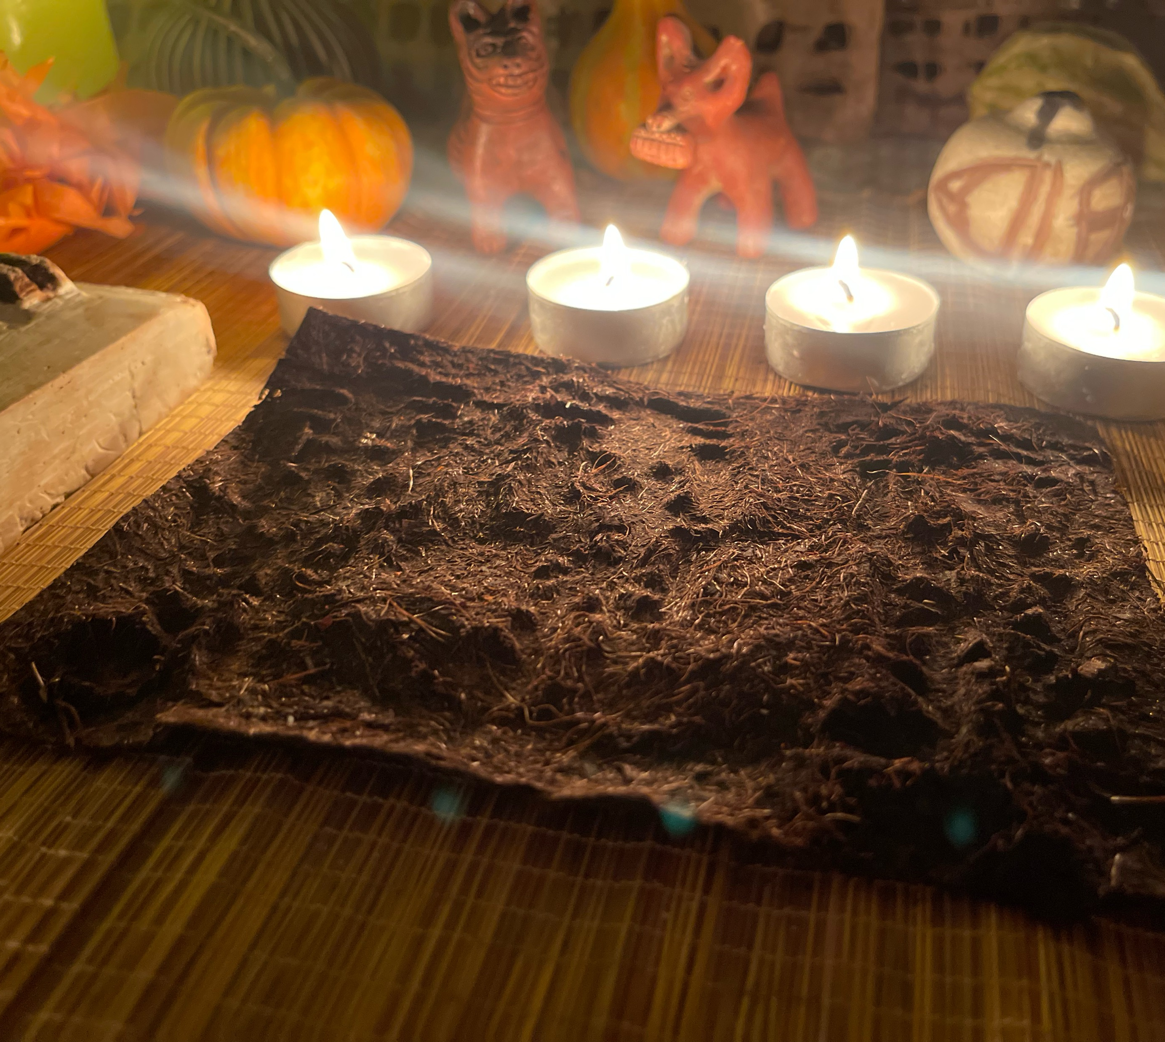
Thank you!
Any Questions?

Slide 10
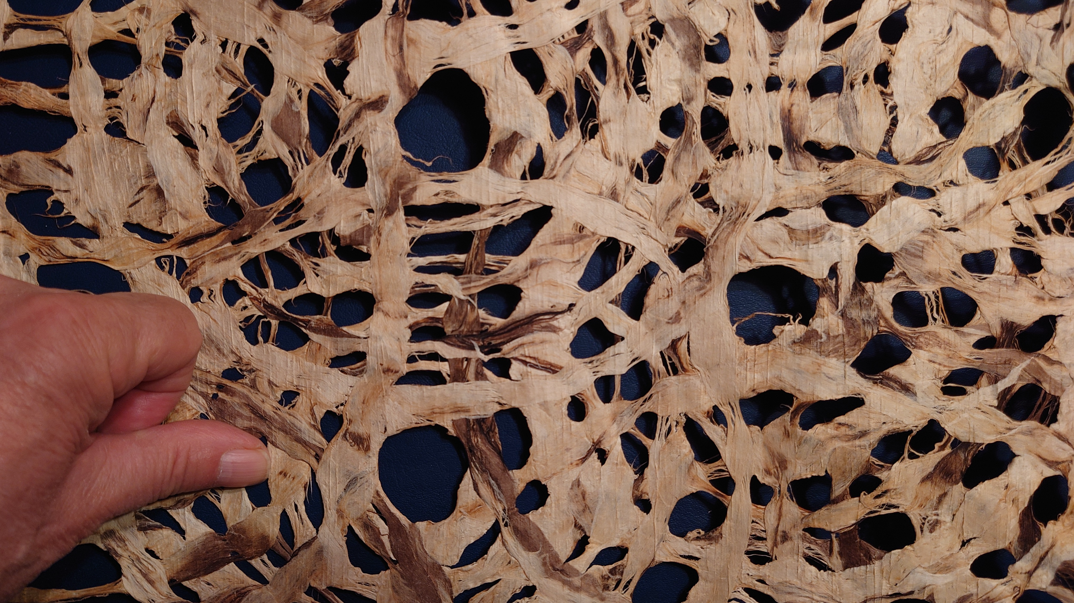
Bibliography
Sandstrom, Alan R., and Pamela E. Sandstrom. Traditional Papermaking and Paper Cult Figures of Mexico. Norman: University of Oklahoma Press; Eurospan distributor, 1987.
Joralemon, Peter David. "Ritual Blood-Sacrifice among the Ancient Maya: Part I." In Primera Mesa Redonda de Palenque, edited by Merle Greene Robertson, 59–75. Pebble Beach, CA: Robert Louis Stevenson School, 1974.
Benz, Bruce F., Lorenza López Mestas C., and Jorge Ramos de la Vega. "Organic Offerings, Paper, and Fibers from the Huitzilapa Shaft Tomb, Jalisco, Mexico." Ancient Mesoamerica 17, no. 2 (2006): 283–296.
Blier, Suzanne Preston. "Ritual." In Critical Terms for Art History, edited by Robert S. Nelson and Richard Shiff, 296–307. 2nd ed. Chicago: University of Chicago Press, 2003.
Neumann, Franke J. "Paper: A Sacred Material in Aztec Ritual." History of Religions 13, no. 2 (November 1973): 149–159. Published by The University of Chicago Press.
Richter, Kim N., and Alicia Maria Houtrouw, eds. Digital Florentine Codex/Códice Florentino Digital. Spanish translation by Miguel García Garagarza. "Book 2: The Ceremonies," fol. 36r. Getty Research Institute, 2023. https://florentinecodex.getty.edu/en/book/2/folio/36r?spTexts=1&nhTexts=1. Accessed April 30, 2025.
Stuart, David. "Codices Mayas." Artes de México, no. 109 (March 2013): 24–35
Richard Marx | stock.adobe.com

